Slide 1


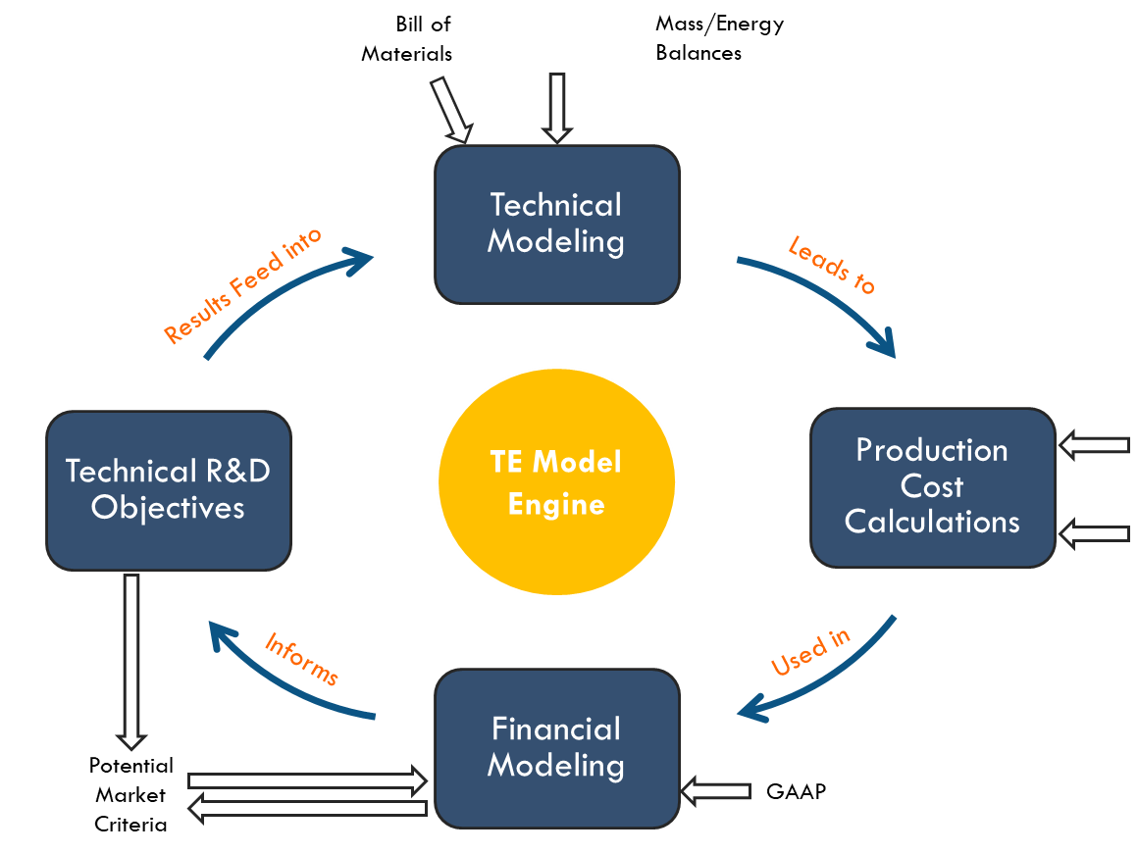
Techno-economic Modeling: An efficient tool to assess/evaluate new technologies and products
Dev Gavaskar, Ph.D.
Partner, True North Venture Partners
Email: dev.gavaskar@truenorthvp.com

Slide 2


Dev Gavaskar: Brief Introduction
Background in Chemical Engineering
Bachelors: Mumbai University, India
Ph.D.: Illinois Institute of Technology
Partner at True North Venture Partners, since 2014
Primary role: Techno-Economic Modeling Principal
Secondary Roles: New Investment Opportunities, Engineering Leadership, Business & Strategic Development.
Before TNVP, held multiple leadership roles across industries for technology scale-up & commercialization.
Technical Advisor at Current Water (http://https://www.currentwater.org/)
Have given this lecture here since 2015 and also give this lecture at Northwestern University (Kellogg School of Management, since 2018)

Slide 3
Lecture Objectives
Define Techno-Economic (TE) modeling and the components that constitute the TE-assessment process.
Explain how TE modeling can be used to inform the design and development of new technologies, and guide a business through its various phase gates at all stages of development
Illustrate these points and generalities with some TE modeling examples
Gain a better understanding for how TE modeling can guide and influence a business based on a new technology from early stages all the way to commercialization
Technical Inputs
TE Model Blackbox
Production Rates/Performance
Cost Inputs
Production Costs

Slide 4










True North Overview
Invests in and Develops Innovative Technologies and Businesses that could
Reshape Core Industries and help the World Transition to a Clean & Sustainable Future.
A 20-year History, to the founding and scale up of First Solar, a global leader in photovoltaics.
We are well-funded (USD 700+ MM) and long-term oriented.
Strategy: Long-Term Value Creation
Core Capabilities
Invest early in the development of promising technologies
Technology assessment and development
Execute “fast fail” programs
Robust Engineering
Commercialization using core engineering methodologies and strong entry markets
Organizational Excellence and Development
Scale rapidly to drive economies of scale and efficient learning cycles
Strategic Marketing
Migrate from entry markets toward disruptive long-term opportunities

Slide 5
TE-Modeling and Investment Phases
4: Ready to Disrupt
Phase Gate:
4
Ramp-up Stage
Models
LT Financial Modeling
Optimize Operations (TOC)
Design FCP
Support Financial Planning
3: Ready to Scale
Manufacturing Cost Models
Phase Gate:
3
Commercial Models
System Level Modeling and Design
BD/Market Evaluation
R&D Roadmap
0: Sourcing/Diligence
1: Go/No-Go
2: Ready for Commercialization
Underwriting/Re-underwriting Investments
Fast Fail Metrics
Commercial Feasibility Design (Preliminary)
Entry Market Feasibility
Concept of Initial Factory
Phase Gates:
0-2
TE-Modeling
Device/Component
System

Slide 6
The Role of Techno-Economic Analyses (TEA)
Techno-Economic Analyses is a “tool” useful in providing quantifiable answers to whether a new technology can scale up sufficiently into market …
TEA is fundamentally an ECONOMIC analysis
However, the fulcrum of the analyses is based on the technical modeling (the “techno” part) of the process/technology/product being assessed
The outputs of this technical model are a function of:
Technical and Economic/Market Assumptions
Available Technical and Economic/Market Information
Known 1st Principles of Core Fundamentals (i.e. Thermodynamics, Kinetics, Manufacturing Principles etc.)
This tool is used to answer questions relating to:
Sensitivities: Does the product unit cost change drastically as a result of small changes in any technical or cost inputs and the impact of approach to theoretical efficiencies? And if so by how much?
Scale: How does scale affect the product unit cost? Do the capital expenses scale well? What is the minimum production size required to cover the production costs?
Cost Extremes: If labor and processing costs were zero, what is the floor production cost?
Markets: Are there unique markets where this technology is advantaged with a novel value proposition to make up for its higher cost? Can we enable new market opportunities by expanding the conditions at which this technology can perform?
The model is not a solution or end game to a problem—rather, it is a versatile tool that changes with technology and business developments, just as much as it impacts these very aspects.

Slide 7
Levels of Techno-Economic Model: Extent of Rigors Needed
Remember: Not every Technoeconomic Analyses needs to be overly complicated. Your first objective is always to determine if the IDEA MAKES SENSE !!!
Preliminary (Sniff Test/Binary Test):
Analysis on absolute basics (e.g., reaction equations, Bill of Materials)
Compare incumbents with the new scheme on Variable Margin basis (i.e., difference of product price and raw material costs)
Moderate (most common to begin with):
Perhaps a preliminary reaction scheme and production yields
Few adders for Fixed Costs (labor, power, M&R etc.)
Some initial capex estimates (from similar processes or manufacturing units)
Full/Comprehensive:
Complete process block diagram
Efficiency Analyses to get a full idea of variable costs and fixed costs
Capital estimation (Level 1 through 3)
No Matter What the LEVEL of TEA – one should have clarity about:
Exact Problem to be Solved
Uniqueness of the Solution
Competition

Slide 8
Functional Block Diagram for a TE-Model
Direct Capital Costs
Installation Factor
Direct Costs:
Instrumentation
Controls
Piping
Electrical
Building/Site Specific
Indirect Capital Costs
Engineering & Supervision
Construction Exp.
Legal Expenses
Contractor’s Fee
Contingency
Efficiency Assumptions
Historical Data
Thermodynamic Calculations
Equilibrium
Heat of Reactions
Multiple Reactions
Process Flow Diagrams
Major Unit Operations
Minor Unit Operations
Process Energy Flows
Definition of the System
Reactants
Products
Equipment CapEx
Design Equations
Empirical Relationships
Reaction Kinetics Assumptions
Material and Energy Balances
Raw Materials
Consumables
Production
Process Energy
Waste Streams
Recycle Rates
Bill of Materials
Bill of Materials is the list of components that go into making the product
Inclusive of Raw Materials and Consumables
Form the foundation of variable costs of a process
Cash Costs
Variable Costs
Fixed Costs
Total Capital Investment
Cost Assumptions
Raw Material Costing
Utilities
Labor
Overhead
Maintenance & Repairs
Hurdle Metric
Cost of Capital
Hurdle Rate
Cost of Production
Project Profitability
Comparative Economics

Slide 9
Production Costs: Cash Costs or OpEx - recurring expenses, measured on an annual basis and categorized into:
Variable Costs
What’s included? | Where do we get it from?
 | Quantity Required | Cost Assumptions*
Raw Materials | Mass & Energy Balances | Technical Reports Spot Pricing Preliminary Market Study Internet information (EIA database, press-releases etc.) Expert interviews Volume Costing considerations
Miscellaneous (e.g., Catalysts)
Process Energy
Process Consumables (e.g., Make-up fluids)
Waste-Streams
Side-Products Credits
Incentives (e.g., RFS, LCFS, Carbon avoidance)
Fixed Costs
What’s included? | Where do we get it from?
 | Quantity Required | Cost Assumptions*
Direct Labor & Supervision (DL, S) | Similar Processes Bottoms-up model | Costs mainly depend on Direct Labor and CapEx Labor Rate should be site specific Further explanations and ranges can be found in: “Plant Design and Economics for Chemical Engineers; Peters, M., Timmerhaus, K., and West, R.”
Supervision (S) | 15% of DL
Plant Overhead | 50-60% of (DL + S)
Maintenance & Repairs | 2-3% of TCI
Insurance & Taxes | 2% of FCI
Lab Charges | 10% of OL
Operating Supplies | 15% of Maint. & Repairs
*Caution: Beware of the trap of using generic cost assumptions! Your TE-model should always be ‘MARKET SPECIFIC’.
E.g. No point using ‘US Natural Gas Pricing’ for a facility in Japan OR ‘Waste Disposal Costs’ of TX for a facility in CA, is there?
Together the Variable and Fixed Costs give the “CASH COSTS of PRODUCTION”, which is sometimes also called as “TOTAL PRODUCTION COSTS”
THESE COSTS GIVE THE ABSOLUTE MINIMUM COST FOR PRODUCING ONE UNIT OF THE PRODUCT

Slide 10
CapEx Estimation
Estimate Type | Source | Accuracy
Order of Magnitude | Similar Previous Cost Data | Over ±30%
Study | Knowledge of Major Equipment | Up to ±30%
Preliminary | Sufficient data to permit estimate to be budgeted | Within ±20%
Definitive | Almost complete data before drawings & specs. | Within ±10%
Detailed | Complete engineering drawings, site surveys etc. | Within ±5%
Pre-Design Capital Cost Estimates
Most of TE-CapEx estimates are of this category
Estimated based on engineering judgments, experience, historical data
Critical for decision making and understanding impacts of various process elements
Effective Method to estimate Capital Investment for a Project (Cost Components of CapEx)
 | Fraction of delivered-equipment cost for plants processing:
 | Solids | Solid-Fluid | Fluid
Purchased Equipment Cost (From Design & Sizing) | 1 | 1 | 1
Direct Costs (DC) | 1.54 | 1.90 | 2.50
Installation Factor | 0.45 | 0.39 | 0.47
Instrumentations & Controls | 0.18 | 0.26 | 0.36
Piping | 0.16 | 0.31 | 0.68
Electrical Systems | 0.10 | 0.10 | 0.11
Buildings | 0.25 | 0.29 | 0.18
Service Facilities | 0.40 | 0.55 | 0.70
Indirect Costs (IDC) | 1.17 | 1.14 | 1.25
Engineering and Supervision | 0.33 | 0.32 | 0.33
Construction Expenses | 0.39 | 0.34 | 0.41
Legal Expenses, Contractor’s Fee | 0.20 | 0.23 | 0.26
Contingency | 0.25 | 0.25 | 0.25
Fixed Capital Investment (FCI = PEC + DC + IDC) | 3.71 | 4.04 | 4.75
Working Capital (15% of TCI) | 0.65 | 0.71 | 0.84
Total Capital Investment (TCI = FCI + WC) | 4.36 | 4.75 | 5.59
A few things to note:
The adjoining numbers have been taken from “Plant Design and Economics for Chemical Engineers; Peters, M., Timmerhaus, K., and West, R.”
While this generic rule of thumb is applicable to a “first of its kind” plant, there is scope of CapEx savings/reductions for future plants, via:
Process Intensification and Packaging
Modularization
Learning Cycles
A much simpler method of estimating CapEx may also be the “Lang Factor” Method, which multiplies the purchased cost of equipment by a factor between 3 and 5
Other CapEx estimation techniques include the “cost-capacity” rule or the “6/10th factor” rule, which is given by:
CapEx_{Cap-2} = (Cap-2/Cap-1)^0.6 * CapEx_{Cap-1}
CapEx is also impacted by location factors. Generally; a facility in a low-cost geography (e.g. China) will cost ~70-75% of a facility in US gulf coast
TCI = 3.2 * Purchased Equipment Cost

Slide 11
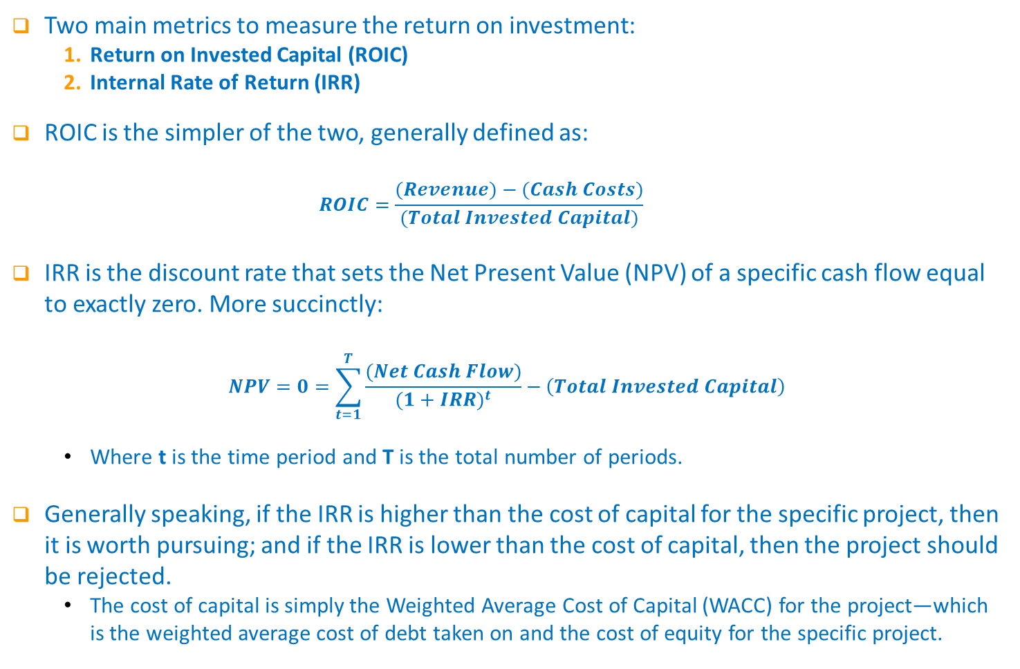
Production Costs: Return on Investment Metrics
Two main metrics to measure the return on investment:
Return on Invested Capital (ROIC)
Internal Rate of Return (IRR)
ROIC is the simpler of the two, generally defined as:
$$ROIC=\frac{(Revenue)−(Cash Costs)}{(Total Invested Capital)}$$
IRR is the discount rate that sets the Net Present Value (NPV) of a specific cash flow equal to exactly zero. More succinctly:
$$NPV=0=\sum_{t=1}^{T}{\frac{(Net Cash Flow)}{{(1+IRR)}^{t}}}−\left(Total Invested Capital\right)$$
Where t is the time period and T is the total number of periods.
Generally speaking, if the IRR is higher than the cost of capital for the specific project, then it is worth pursuing; and if the IRR is lower than the cost of capital, then the project should be rejected.
The cost of capital is simply the Weighted Average Cost of Capital (WACC) for the project—which is the weighted average cost of debt taken on and the cost of equity for the specific project.

Slide 12
Minimum Viable Plant (MVP): Concept
Definition: MVP is the scale that is “big” enough to retire the scale-up risks and “smallest” enough to meet the ‘economic targets’
Meet Economic Targets: Meet a certain ‘Return on Capital Investment’: First target can be, e.g., Revenue equal to the ‘cash costs’ of the plant (i.e., ROIC = 0%)
Retire the Scale-up Risks: This comprises of:
Prove out technology…. Meet targets achieved in the lab that prove out economics.
Prove out product…. First-gen product that can/will be accepted in the market.
Procure Future Partnerships & Investments…. Proven technology eases the burden for the ‘commercialization’ plans of the technology
Other Advantage(s):
Potential for use as a platform for technological pivots and developments
The Smaller the MVP the more economical & transformative your technology is…

Slide 13
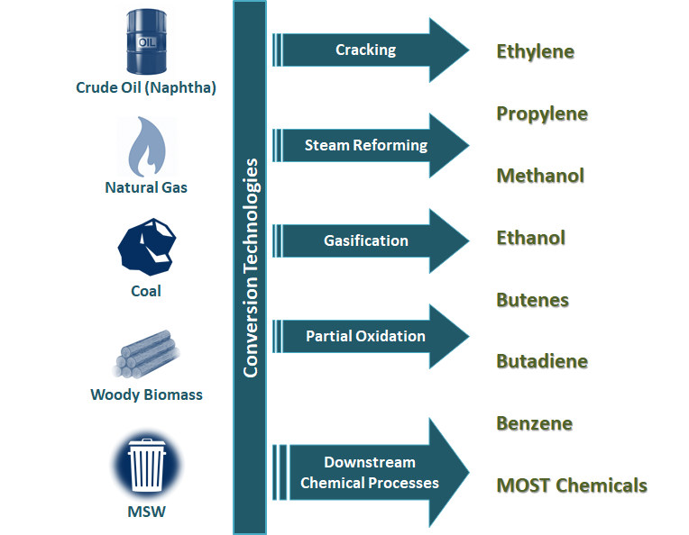
Refresher Question – 1: Choice of feedstock
You have a technology that converts carbonaceous/fossil feedstocks into products – via different conversion techniques. Based on the information below, which feedstock will be the most advantageous for this technology? What is the assumption for your choice?
Feedstock | Price of Feedstock | Energy Density
Coal | $40/mt | 5,100 kcal/kg
Petcoke | $110/mt | 8,300 kcal/kg
Regas. LNG | $12.2/MMBtu | -
Crude Oil | $60/bbl | 10,880 kcal/kg
Prices of various energy feedstocks ($/MMBtu)
1 kcal = 3.96567 Btu
1 mt = 7.33 bbl.
Main Assumption to Reach this Conclusion: Energy Efficiency of Conversion of all Feedstocks to Syngas IS THE SAME!

Slide 14

Refresher Question – 2: Electrolysis
An electrolyzer technology, splits water into hydrogen and oxygen using electricity. Which of the below choices form the main variable cost components of the process?
Instrumentation & Controls
Water
Electricity
Current Collectors & Separators
None of the Above
All of the above
Note: The general working of an electrolyzer constitutes of a degradation rate of the electrodes at some rate. After the degradation rate has fallen below a certain level, the “stack” is replaced. The “stack” comprises of the entire assembly of the coated electrodes. As is expected, to keep costs low one would want the degradation rate to be as low as possible
Variable costs, by definition, refer to the expenses directly associated with the production. These costs include expenditures for raw materials, consumables, process energy and utilities.

Slide 15
TE-Modeling Example 1: Assessing a New Technology

Slide 16
A Potential Breakthrough Technology Comes Along…
You come across an article in the ‘Science’ journal that outlines a potentially path-breaking chemistry, borne out of an institute. The chemistry essentially converts an olefin (e.g., propylene) to a higher value diol (e.g., propylene glycol) in an aqueous process at moderate temperatures and pressures in one step! You do some due diligence and find out the following:
Technical Points:
The current route for making propylene glycol is a two-step high temperature, high pressure process involving oxidation of polymer-grade propylene to propylene oxide and then further hydration of propylene oxide to propylene glycol.
The above route also yields di-propylene and tri-propylene glycols as side products
The new process takes place at 120 C and almost atmospheric pressures, in the presence of an inert solvent with a catalyst complex dissolved in it.
Preliminary reaction kinetics are known, as is the general stoichiometry and overall reactions.
Market and Business Information:
Propylene glycol is a $4B market, with an average sale price of 89¢/lb
Polymer grade propylene is available at a cost of 60¢/lb

Slide 17
So How do you assess the opportunity?
Determine Chemical Reactions and Balance Them
What do we intend to achieve at the end of this exercise?
A reasonable first estimate of production costs from the new process:
Cash Costs (fixed + variable)
Total Production Costs (Depreciation + Cash Costs)
Product Value (ROIC + Total Production Costs)
Comparative economics with the existing route
An ROIC or an IRR based evaluation of a commercial plant performance
AND MOST IMPORTANTLY:
What technical risks (binary and others) should be retired to ensure that this science experiment can scale into something compelling and profitable?
Come up with a Process Scheme and Mass/Energy Balance
Design and size Main Equipment
Estimate CapEx and OpEx
Calculate the Production Costs

Slide 18
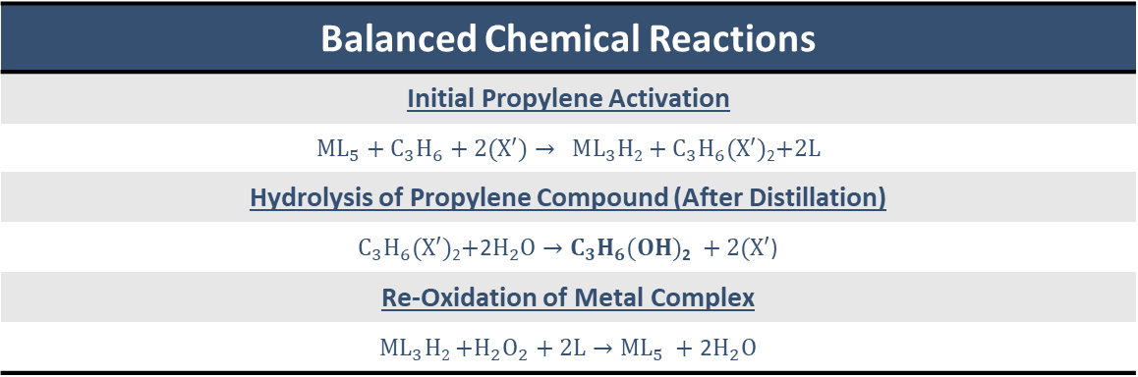
Listing The Governing Equations
Balanced Chemical Reactions
Initial Propylene Activation
$M{L_{5}+C_{3}H_{6}+2(X′)→ }_{ }$ $ML_{3}H2+C_{3}H_{6}(X′)$₂$+2L$
Hydrolysis of Propylene Compound (After Distillation)
$C_{3}H_{6}(X′)$₂$+\text{2}H_{2}O{→C_{3}H_{6}(OH)\text{2}}_{ }+$ $2(X′$)
Re-Oxidation of Metal Complex
$ML_{3}H2{+H_{2}O_{2}+2L→ML_{5}}_{ }+$ 2$H_{2}O$
Where:
L = Organic Ligand
M = Metal Catalyst
X’= Activation Species
These equations also do the job of providing the bill of materials for this process.
There will be other materials required to be a part of this entire process, known as consumables (e.g. solvents), but they do not go into creating the product itself.

Slide 19
Creating a Basic Process Flow
Recycled C₃H₆
Side Gases
Off-Gassed C₃H₆
H₂O₂/H₂O
H₂O/X’/ Propylene ester to Separations
Distillation Tower (D-1)
Likely to be some kind of more complex distillation in Separations
Propylene Activation Reactor (R-1)
Re-Oxidation Reactor (R-2)
X% ML5 Conversion, Y% ML5 Selectivity
100% Propylene to Di-ester Selectivity
Make-Up X’
Solvent, ML₅
Make-Up C₃H₆

Slide 20
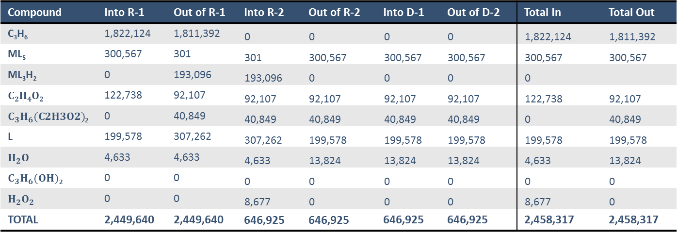
Calculating an Ideal Mass Balance
Compound | Into R-1 | Out of R-1 | Into R-2 | Out of R-2 | Into D-1 | Out of D-2 | Total In | Total Out
C₃H₆ | 1,822,124 | 1,811,392 | 0 | 0 | 0 | 0 | 1,822,124 | 1,811,392
ML₅ | 300,567 | 301 | 301 | 300,567 | 300,567 | 300,567 | 300,567 | 300,567
ML₃H₂ | 0 | 193,096 | 193,096 | 0 | 0 | 0 | 0
$$C2H4O2$$ | 122,738 | 92,107 | 92,107 | 92,107 | 92,107 | 92,107 | 122,738 | 92,107
$C_{3}H_{6}(C2H3O2)$₂ | 0 | 40,849 | 40,849 | 40,849 | 40,849 | 40,849 | 0 | 40,849
L | 199,578 | 307,262 | 307,262 | 199,578 | 199,578 | 199,578 | 199,578 | 199,578
$$H_{2}O$$ | 4,633 | 4,633 | 4,633 | 13,824 | 13,824 | 13,824 | 4,633 | 13,824
$$C_{3}H_{6}(OH)\text{2}$$ | 0 | 0 | 0 | 0 | 0 | 0 | 0 | 0
$$H_{2}O_{2}$$ | 0 | 0 | 8,677 | 0 | 0 | 0 | 8,677 | 0
TOTAL | 2,449,640 | 2,449,640 | 646,925 | 646,925 | 646,925 | 646,925 | 2,458,317 | 2,458,317
All in units of kg/h
The only extra information needed to create this table are the molecular masses of each compound, which can be easily found in literature.
Energy balances for this process can simply be preformed around each unit operation.
If the temperatures needed for each step are known, heating requirements can be calculated, which are used to calculate raw material amounts needed for heating—such as natural gas.

Slide 21
Equipment Included in CapEx Estimation
Equipment | Metrics used for equipment design in TE-model
Propylene Activation Reactor | Designed as a bubble column reactor (BCR), with X% M conversion and Y% selectivity of M to propylene di-acetic esters Reaction kinetics obtained from lab data Pressure, propylene feed rate, and Temperature calculated to achieve the required conversion in the given residence time
Flash Tanks | Two vertical flash tanks designed after the BCR to flash off all remaining propylene in solution Sized according to the Souders-Brown equation for maximum allowable vapor velocity
Re-Oxidation Reactor | Ideal CSTR. Model splits one reactor into multiple, parallel reactors if one becomes too large Reaction kinetics obtained from lab data
Downstream Separation | Expected to be typical distillation tower with the associated re-boiler, condenser and pumps Tower separates out propylene-esters, trace propylene glycol, acetic acid, and water from bulk solution
Post-Processing | Post-processing of Propylene-esters away from bulk solution avoids unnecessary oxidation of M(III) This step is assumed to be some sort complex distillation scheme. There is older literature to give a good idea of how this will be designed
Balance of Plant | Product storage, raw material storage, ancillary, pumps, compressors, OSBL equipment
Land | Estimated using the land requirements for typical process industry

Slide 22
Total Capital Investment (TCI) Estimation
Equipment | Source and Costing
Total Purchase Equipment Cost (TPEC) | Total Purchased Equipment Cost (TPEC) of reactors estimated from reactor design, weight of steel, required internals etc. Additional, major equipment includes Distillation towers.
Total Installed Equipment Cost (TIEC) | TIEC = 1.4 x TPEC
Total Direct Costs (DC) | DC = 1.6 x TPEC
Total Indirect Costs (IC) | IC = 0.67 x TPEC
Fixed Capital Investment (FCI) | FCI = TIEC + DC + IC
Cost of Land (CoL) | CoL = 6% of FCI
Contingency (T_{Con}) | T_{Con}= 15% of FCI
Total Capital Investment (TCI) | TCI = FCI + CoL + T_{Con}

Slide 23
Annual Operation & Maintenance (OpEx) Assumptions
Inputs | Base-Case and Sensitivity Ranges
Feedstock Costs (Propylene) | Assumption: Polymer-grade Propylene Available Propylene costs corresponding to oil prices (Propylene assumed to be made from Naphtha cracking)
Solvent Cost | Prices based on historical pricing data in the US
OpEx due to Losses | Losses of solvent, oxidant etc. considered in terms of $/tonne product Base-Case: No Losses Ranges: $0-$150/tonne
Re-Oxidation Agent Cost | Assumed to be 50% (w/w) solution of H₂O₂ in water Bulk pricing available from commercial vendor sources
Plant Utilities | Energy required calculated in a bottom-up method depending on unit operation conditions
Operating Labor | Fixed Costs such as operating labor, maintenance & repairs and other miscellaneous costs were determined from the incumbent process for making propylene glycol (i.e. from propylene oxide).
Maintenance & Repairs
Miscellaneous

Slide 24
Comparative Economics with Incumbent Process
 | New Process | Incumbent Process | MVP* Economics
Product Capacity, tonne/yr | 181,000 | 181,000 | 5,980
Total CapEx, $ millions | $103.5 | $471.5 | $19.4
Variable Costs of Production, ¢/kg | 119.95 | 172.82 | 122.21
Total Raw Materials | 118.49 | 144.00 | 119.46
By Product Credits | (0.00) | (21.96) | (0.00)
Energy/Utilities | 1.46 | 50.78 | 2.75
Fixed Costs of Production, ¢/kg | 17.87 | 30.15 | 43.21
Maintenance & Repair | 1.11 | 5.90 | 6.87
Operating Supplies & Labor | 1.11 | 2.35 | 12.46
Plant Overhead, Taxes, Insurance, Lab, & Distribution | 15.65 | 21.90 | 23.88**
Product Value Calculations, ¢/kg
Total Cash Cost of Production | 137.82 | 202.97 | 165.42
Depreciation-10 Year Straight Line | 5.44 | 24.01 | 30.79
Total Full Production Cost | 143.26 | 226.98 | 196.21
Return on Investment (To Drive a 25% ROI) | 14.30 | 65.12 | -
Total Product Value | 157.56 | 292.10 | 196.21***
*MVP = Minimum Viable Plant
**ROIC not included in MVP calculation
***Assumption is that propylene glycol is sold at 196.21 ¢/kg
To drive a 25% ROI, the incumbent process needs to value its product 1.9X higher than the new process.
Put another way, if the new process sells at product value parity with the incumbent, the ROI would be 260%. Quite an attractive opportunity!
Notes:
Combined the PEP economics for the PO process and PG process. CapEx was simply added for the two; in reality there would be synergies where the total CapEx of a combined plant like that would be less than the sum of the two separate plants, but it is good enough for this estimate and still would not approach the economics of the new process even if you gave all the benefits of the doubt you could think of (also same for operating labor). Distribution costs for the incumbent process were simply the reported costs of the PG process and not the sum of the two, since it is assumed the PO process is integrated within the entire plant and would not have distribution costs. ROIC for the incumbent process is the amount required to return 25% on the entire combined CapEx, not just on the PG process CapEX. All numbers shown at 100% nameplate capacity.

Slide 25
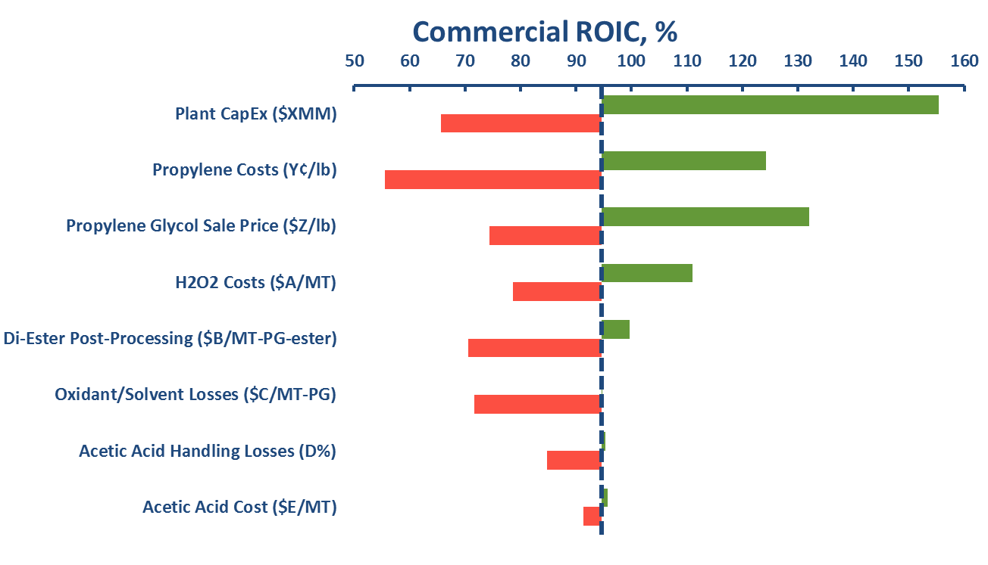
Qualitative Example of Sensitivity Analysis
Notes:
The high and low values were taken off to keep it clean. During the presentation it can easily be explained that each bar represents where the ROIC falls at a different extreme value.

Slide 26
Technical Risks That Must be Addressed
Risk Item | Mainly Impacts: | Binary Risk?
Technical parameters like: Conversion, Selectivity to Products etc. | CapEx & OpEx | Yes
Commercial availability and non-toxic nature of consumables (e.g. solvents) | OpEx & Supply Chain | Yes
Any other losses (e.g. solvent evaporation, reactant oxidation, catalyst deactivation)? | OpEx | No
Can the process be demonstrated to run in a continuous fashion? If it must be run in batch operations what might this mean for the process scheme and ultimately the economics? | CapEx | No
Any scale-up risks? Proven commercial history of all unit-operations in the process scheme? | CapEx | No
Stability (thermal, mechanical, corrosivity) of the chemicals and materials involved? Should the chemicals be sourced, or produced in-house? | Supply Chain, CapEx and possibly OpEx | Maybe

Slide 27
TE-Modeling Example 2: CapEx Affordability

Slide 28



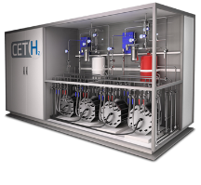

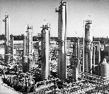

CapEx Affordability Analyses: (A Top-Down Means of Vetting an Opportunity)
Renewable Energy
Natural Gas
Electrolysis
SMR for Hydrogen
NewCo.
Haber Bosch
Ammonia

Slide 29
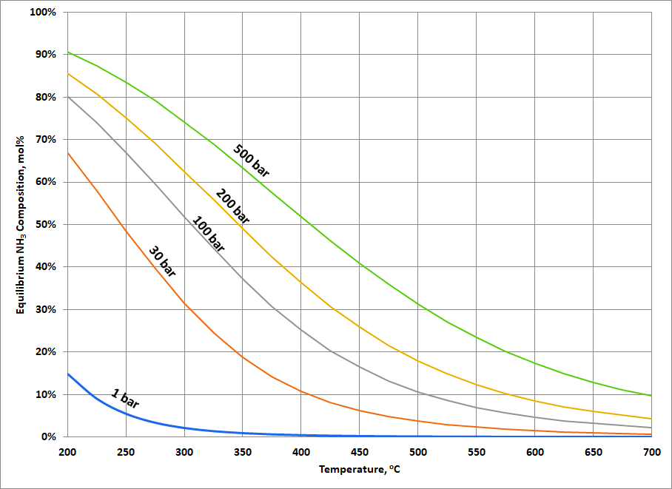
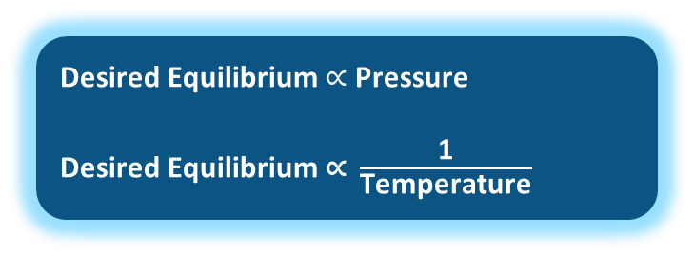
Ammonia Synthesis: Need for an Alternative Approach?
Synthesis of ammonia (‘Haber-Bosch’ Process) is plagued with challenges due to unfavorable thermodynamics of the reaction:
N2(g) + 3H2(g) = 2NH3(g)
The above reaction is exothermic and is favored at low temperatures and high pressures
Ammonia Yield is Maximized (see Figure) by:
Minimum Temperature &
Maximum Pressure
This is counter-productive to process design as:
Low Temperature = Slow Reaction Kinetics
High Pressure = Expensive Equipment (i.e. reactors, compressors, piping etc.)
To reach a compromise, the industrial Haber Bosch Process is operated at temperatures of ~450ºC and pressures of ~200-220 atm. in the presence of a catalyst
The traditional Haber Bosch Process is plagued by HIGH CAPITAL COSTS, which necessitate building high capacity plants to leverage economics of scale
Path to Desired Equilibrium
Decreasing Temperature
Increasing Pressure
Desired Equilibrium $∝$ Pressure
Desired Equilibrium $\text{∝ }\frac{\text{1}}{\text{Temperature}}$
An Alternative that can improve reaction kinetics at lower temperatures and still leverage the equilibrium benefit at reasonable pressures, is hence interesting

Slide 30
Questions to be Answered:
At the given operating conditions what is the efficiency of the NewCo. Process?
What are the main factors that the economics of the process are heavily dependent on? Some of these may include:
Catalyst Costs and Replacement Intervals
Efficiency of the Electrolyzer
Capital Cost of the Electrolysis Section
Scale of the Plant
Renewable Energy Costs
Solar or Wind Profile, which impacts the capacity factor and hence the size of the electrolyzer
The following analyses answers the above question by calculating the “Maximum CapEx” for the NewCo. process that would make it economically comparable with the traditional Haber-Bosch Process

Slide 31
CapEx Affordability Analyses (Approach)
New Tech. CapEx Affordability
CapEx Affordability Analyses
Cost Model for HB Ammonia
Feedstock Costs and Efficiency*
Cost Model for NewCo. Ammonia
Renewable Energy
Natural Gas
Other Variable Costs**
Fixed Costs***
Electrolysis
SMR for Hydrogen
Prod. Costs for HB Ammonia
Solve for Cost Parity
Prod. Costs for NewCo. Ammonia
NewCo.
Haber Bosch
Estimate Total CapEx for New Technology
Ammonia

Slide 32
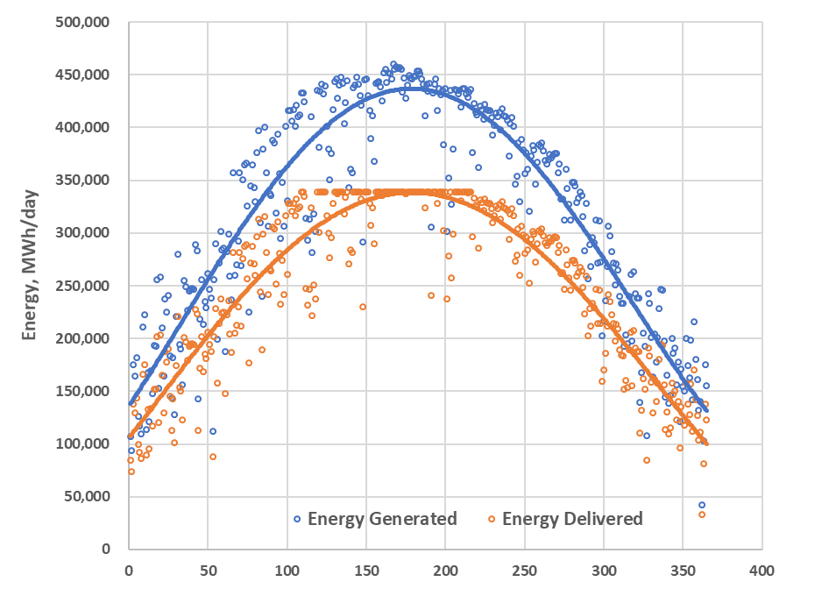
Calculating the Electrolyzer Size Requirement*
Electrolyzer Size Calculated by Minimizing Levelized Cost of Hydrogen Production for the adjoining Inputs/Assumptions
Calculated from the following inputs/assumptions:
A given solar farm load profile
Assuming purpose built solar PV farm
Installed Electrolyzer CapEx of $300/kW
Available energy price of $0.025/kWh
O&M costs of Electrolyzer: $ 20/kW/yr
Electrolyzer System Efficiency: 78.8% (Energy Req. = 50kWh/kg)
Efficiency Degradation of 0.75% per year (linear)
Discount Rate: 7.5%; Project Life: 30 years

Slide 33
Base Case TE-Analyses Comparison
Technology for Ammonia | M.W. Kellogg (Haber-Bosch) | NewCo.
Technical Parameters
Source of Hydrogen | Natural Gas | Electricity
Hydrogen Generation Process | SMR | Water Electrolysis
Hydrogen Generation Energy Requirements | 0.1485 MMBtu/kg ¹ | 0.1706 MMBtu/kg ²
Ammonia Energy Requirements | 30.074 MMBtu/mt. ³ | 31.804 MMBtu/mt. ⁴
Operating Temperature | 450 C | 565 C
Operating Pressure | 200 atm. | 10 atm.
Equilibrium One-Pass Conversion ⁵ | 26% | 0.7%
Economic Parameters
Capacity of the Plant, kmtpy | 300 ⁶ | 200 ⁷
Corresponding SMR Size, MMNm3/yr | 592 | -
Corresponding Electrolyzer Rating, MW ⁸ | - | 288
Total Capital Investment | $ 327 | $ 143
Hydrogen Generation Section, $MM ⁹ | $ 132 | $ 86
Ammonia Synthesis Section, $MM | $ 195 | $ 26 ¹⁰
Total Production Costs (12% ROIC), ¢/kg | 39.96 | 39.96
Feedstock Costs, ¢/kg ¹¹ | 10.53 | 32.77
Other Variable Costs, ¢/kg | 1.37 | 1.31
Total Fixed Costs, ¢/kg ¹² | 7.74 | 4.79
Depreciation/Sust. CapEx, ¢/kg ¹³ | 10.89 | 0.86
Profit @ 12% ROIC, ¢/kg ¹⁴ | 13.06 | 1.55
Notes:
Calculated from available mass and energy balances of a world-scale SMR. Based on LHV of natural gas. SMR Process efficiency is ~82%
Calculated from energy requirement of electrolysis of 50kWh/kg (Electrolyzer Efficiency: ~79%)
Energy Requirements for Haber Bosch process determined from theoretical calculations and SRI PEP Economics (Overall Thermal Efficiency: 87.7%; Theoretical to Actual Ratio)
Estimated from Stoichiometry and assuming 5% losses in recycle, product separation & recovery etc.
Estimated from thermodynamic equilibrium
Preliminary research shows that this is a typical plant size of an ammonia plant based on this process
Plant based on this technology assumed 100 kmtpy smaller than the incumbent plant
Calculated by minimizing levelized cost of hydrogen production for the given electrolyzer efficiency and a typical solar load profile.
SMR CapEx calculated from the SMR TE-model. Electrolyzer CapEx calculated based on an installed electrolyzer CapEx cost of $300/kW
Ammonia Synthesis CapEx section for NewCo is the “Maximum Affordable CapEx” needed to equalize the total production costs of ammonia from the two processes.
Natural Gas: $3.5/MMBtu, Renewable Electricity: 2.5¢/kWh. Feedstock costs for Starfire is the levelized cost of hydrogen production from electrolysis accounting for the electricity costs, electrolyzer CapEx, electrolyzer O&M, cost of capital, replacement CapEx, sustaining CapEx, capacity factor and efficiency.
Fixed costs include labor, maintenance and repairs, overhead, taxes and insurance etc. For NewCo. these costs are costs associated only with the ammonia synthesis section as the fixed costs for hydrogen generation are included in the feedstock costs.
Sustaining CapEx/Depreciation for NewCo. is calculated based on the Ammonia Synthesis Section CapEx ONLY. Calculated on 15 yr straight line basis for both processes
ROIC for NewCo calculated only for the Ammonia Synthesis Section

Slide 34
TE-Modeling Example 3: Assessing Factory Flow and Set-up

Slide 35
Cost Models for Manufacturing Decisions
Determine the optimum combination from the information below:
Factory Process Flow
Manufacturing Operations: Basic Technical Information

Slide 36
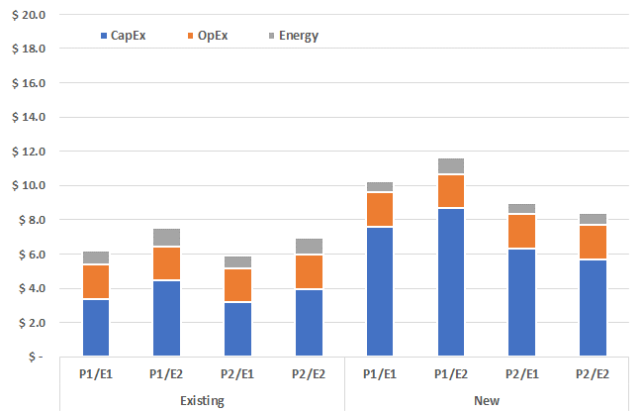
Results: Minimizing the Production Costs
Combination of the P2 Filter, E1 Extrusion with the Existing Furnace is the best combination

Slide 37
BUT Process Qualification is Very Important!

Slide 38
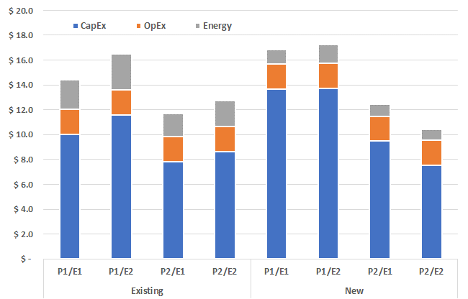
Results: Now They Say a Different Story
Combination of the P2 Filter, E2 Extrusion with the New Furnace is the best combination

Slide 39

Questions/Discussion

